Slide 1


Genome-wide Association Study
02/11/2019
Qi Yan
Department of Pediatrics
Children’s Hospital of Pittsburgh of UPMC
University of Pittsburgh

Slide 2
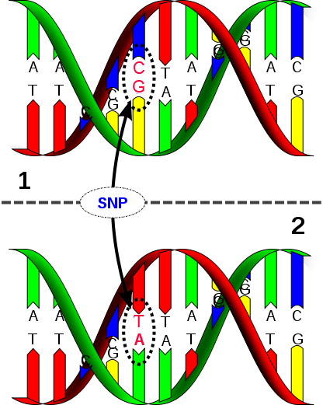
Human Genome and Single Nucleotide Polymorphisms (SNPs)
23 chromosome pairs
3 billion bases
A single nucleotide change between pairs of chromosomes
E.g.
Haplotype1: AAGGGATCCAC
Haplotype2: AAGGAATCCAC
Notes:
So, what does the genetic data look like? You know, as human, we have 23 chromosome pairs. This is a pair of chromosomes. Each chromosome consists of two complementary strands. Because they are complementary, we only look at one strand. In this example, we look at green strand. This is the green strand from the first chromosome; this is the green strand from the second chromosome. The green strand is called one haplotype. So each person has two haplotypes for each chromosome pair. One from father, one from month. At the first location, we call it SNP1, the genotype of SNP1 is AA, the genotype of SNP2 is AA too, so on so forth. And the SNP consists of two alleles, the first allele is A, the second allele is A. If there is variation occurring between the two base pairs. We call it polymorphism. This is what genetic data look like.

Slide 3
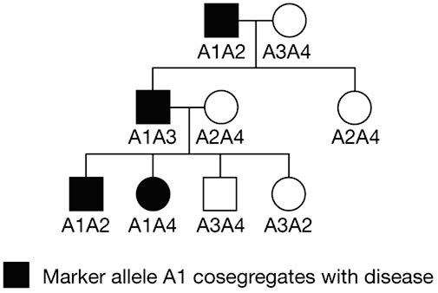
Where are Genes?
Kullo et al. Nature Clinical Practice Cardiovascular Medicine (2007)
Notes:
Then we want to find out if there is an association between disease and genetic variants. In this family tree, circle stands for female, square stands for male, black stands for disease, white stands for no-disease. These are the two haplotypes from each subject. As you can see, all the family members with disease have a portion of this black haplotype. So this black haplotype could be associated with the disease.

Slide 4
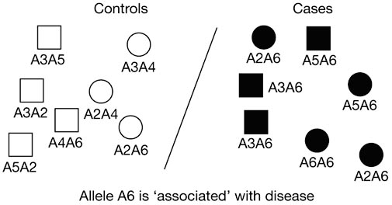
Association Study in Population
Kullo et al. Nature Clinical Practice Cardiovascular Medicine (2007)
Notes:
Here is another example, instead of families, we look at the genetic variants in population. All cases have the allele A6 which could be associated with disease.

Slide 5
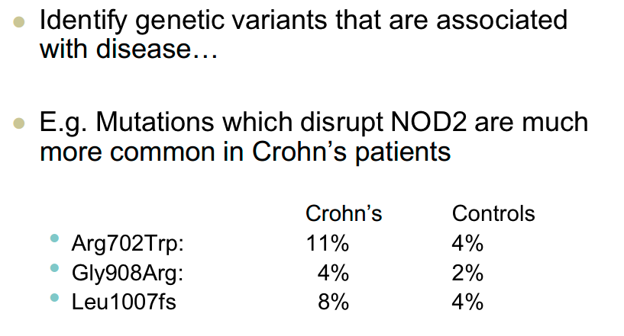
What are Genes?
Notes:
Another example, Mutations which disrupt NOD2 are much more common in Crohn’s patients. These are the amino acid mutation and this mutation is determined by genes.

Slide 6
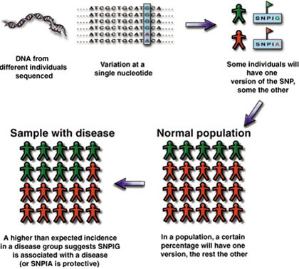
Using SNPs to Track Predisposition to Disease
© Gibson & Muse, A Primer of Genome Science
Notes:
We can use SNPs to track predisposition to Disease. This is a good flow chart, we first sequence DNA from different individuals, then we find . . . In normal population the ratio between SNP1G and SNP1A is like this, while in disease samples, the ratio is quite different, so this SNP could be associated with the disease.

Slide 7
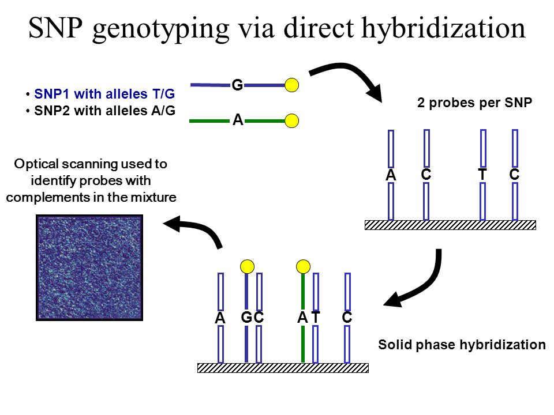
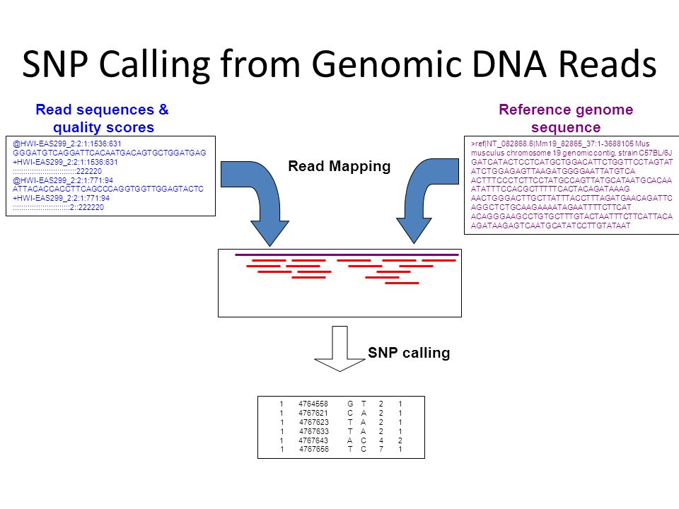
SNP Data
www.cd-genomics.com
BIBM 2011 Tutorial
 | SNP1 | SNP2 | SNP3 | …
Sample1 | A/A | G/G | G/G | …
Sample2 | A/A | A/G | G/G | …
Sample3 | A/C | G/G | G/G | …
… | … | … | … | …
 | SNP1 | SNP2 | SNP3 | …
Sample1 | 0 | 2 | 2 | …
Sample2 | 0 | 1 | 2 | …
Sample3 | 1 | 2 | 2 | …
… | … | … | … | …
OR

Slide 8
SNPs in Population
CAGATCGCTGGATGAATCGCATC
CGGATTGCTGCATGGATCGCATC
CAGATCGCTGGATGAATCGCATC
CAGATCGCTGGATGAATCCCATC
CGGATTGCTGCATGGATCCCATC
CGGATTGCTGCATGGATCCCATC
SNP1
↓
SNP2
↓
SNP3
↓
SNP4
↓
SNP5
↓

Slide 9


Association Study in Case Control Samples
SNP4
↓
CAGATCGCTGGATGAATCGCATC
CGGATTGCTGCATGGATCGCATC
CAGATCGCTGGATGAATCGCATC
CAGATCGCTGGATGAATCCCATC
CGGATTGCTGCATGGATCCCATC
CGGATTGCTGCATGGATCCCATC
SNP1
↓
SNP2
↓
SNP3
↓
SNP5
↓
Disease
Notes:
We can use SNPs to study complex diseases. Assume we already have the genotypes for many samples, we can study the association between disease and SNPs using statistical models. SNPs are valuable resource that we can use to identify regions of genome that cause disease

Slide 10
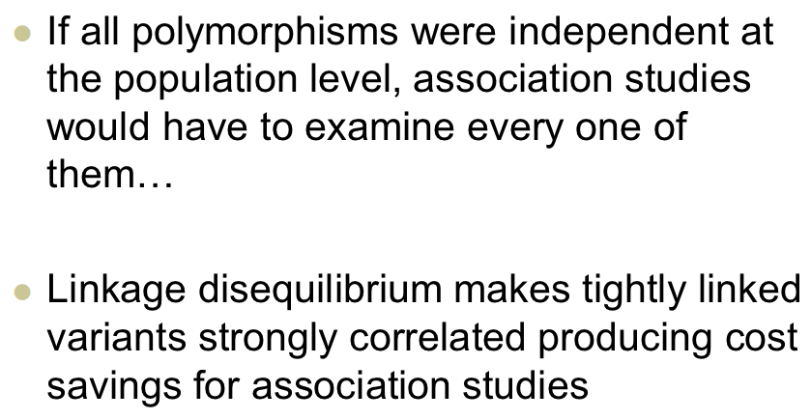
Association Studies and Linkage Disequilibrium
Notes:
… It means we need to exam SNP1, SNP2 … one after another.

Slide 11
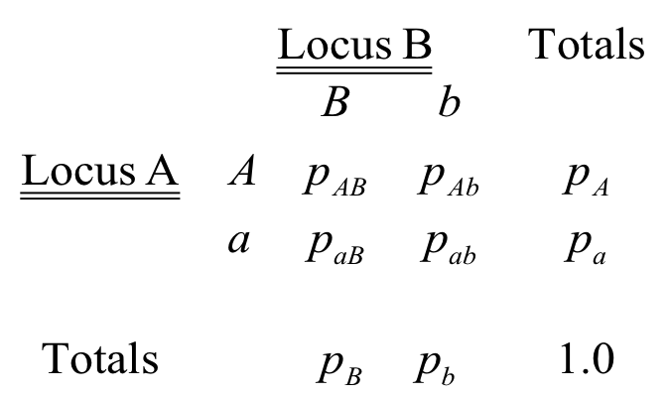
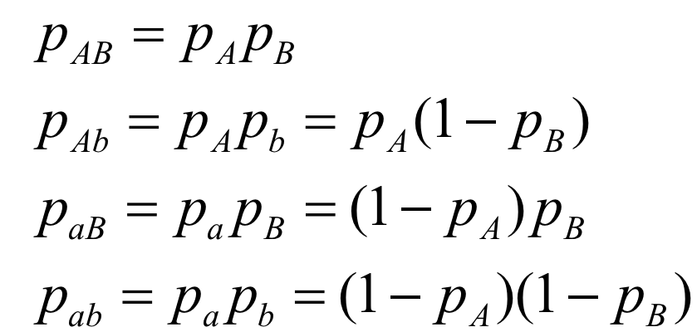
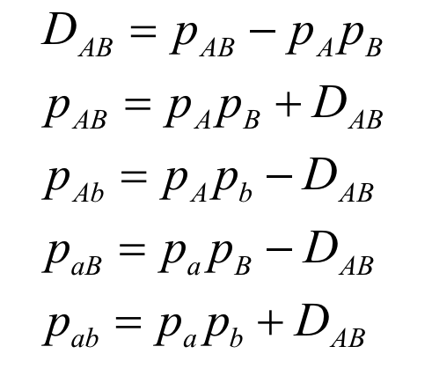
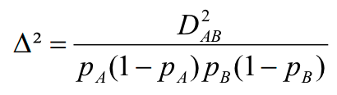
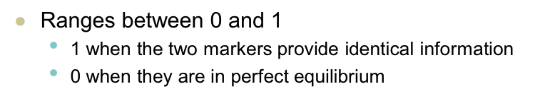
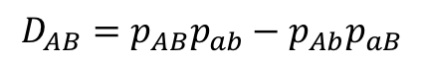
Linkage Disequilibrium (LD)
$$D_{AB}=p_{AB}p_{ab}−p_{Ab}p_{aB}$$
Notes:
The short version is LD. You can think of it as correlation between SNPs. In this case, SNP3 and SNP4 and perfectly correlated, and they have LD of one.

Slide 12
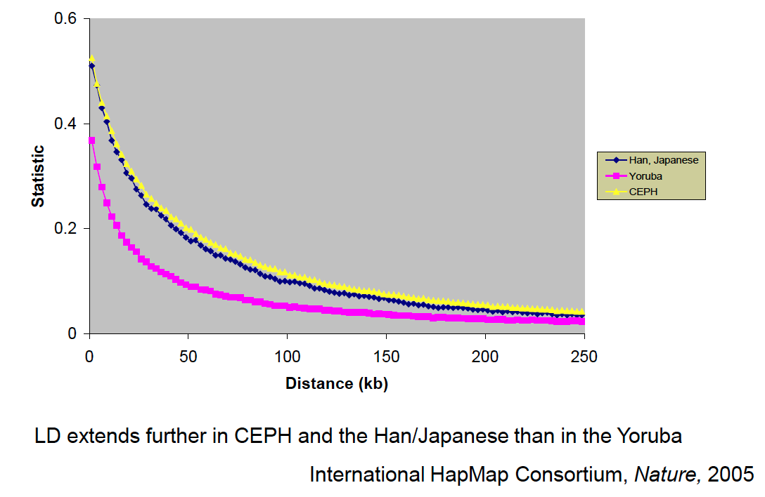
LD in Population
Notes:
As you can see, if SNPs are close to each other, they will have high LD, or high correlation. The yellow line is European, the blue line is Asian, and the pink line is African. So Africans have lower LD than the other two populations. I guess this support the theory that all human come from Africa, because after generation and generation, the LD should decrease over time. The plot may indicate that Africans have much longer time of evolution.

Slide 13
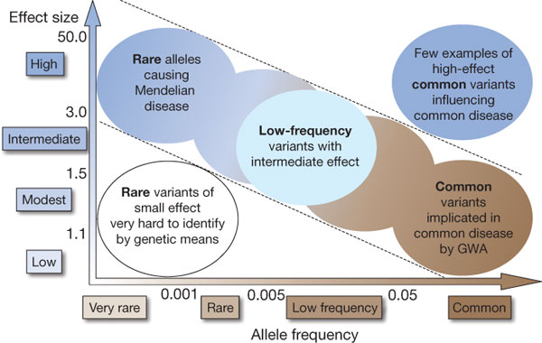
Genetic Spectrum of Complex Diseases
Manolio et.al. 2009 Nature 461, 747-753

Slide 14
Genetic Spectrum of Complex Diseases
Linkage
Sequencing
GWAS
Notes:
Genome-wide association studies (GWAS) is designed to identify possible genetic variants that contribute to complex diseases. In the past five years, more than 100 complex diseases have been studied by GWAS and numerous susceptibility genes/loci were identified.
However, the GWAS have only identified a small fraction of the heritable variation of these diseases^{[1]}. One explanation is that many rare variants (a minor allele frequency, MAF<5%), which are not included in the common genotyping platforms, contribute substantially to the genetic variation of these diseases^{[2]}. Now, the so-call next generation sequencing technology is available, which can be used to sequence rare variants and help us to find the missing association. I’ll elaborate this in the next lecture. This (GWAS) is our today’s focus.

Slide 15

Genome-Wide Association Study
© Francis Collins, 2008
© Francis Collins, 2008
Notes:
In this figure, each lamp is like a SNP or genetic variant, the key is the disease. We want to find the key is next to which lamp. What we do is that we check the lamp one by one.

Slide 16
Progress in Genotyping Technologies
10²
ABI
TaqMan
ABI
SNPlex
10
Illumina
Golden Gate
Cost per genotype (Cents, USD)
Affymetrix
MegAllele
Affymetrix
10K
Illumina
Infinium/Sentrix
1
Perlegen
Affymetrix
100K/500K
Nb of
SNPs
1
10
10²
10³
10⁴
10⁵
10⁶
2001
2005
Courtesy S. Chanock, NCI
© Francis Collins, 2008
Notes:
The progress in genotyping or sequencing technologies. It is getting cheaper and more powerful. It’s still expensive if you want to do genome wide study. This trend is similar to computer.

Slide 17
Publications
http://www.genome.gov/

Slide 19
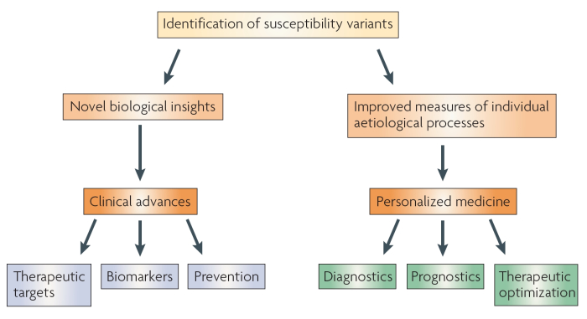
Clinical translation of findings from GWAS
McCarthy, M. et al. 2008 Nature Reviews Genetics
Notes:
This is the clinical translation of findings from GWAS. This is what we what to achieve from GWAS, but we are far from there yet.
Tell a comprehensive story about biological function.
Warfrin study

Slide 20
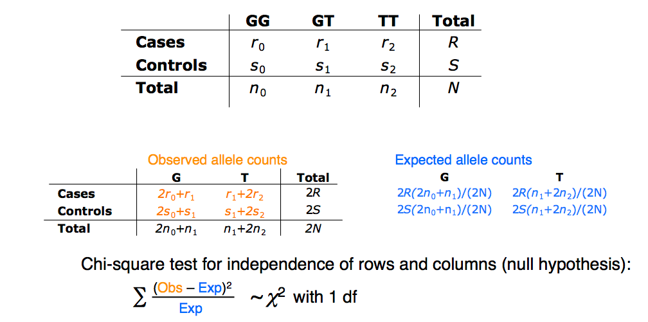
Allelic Test for Association
Notes:
This is one simple method to test the association between diseases and SNPs. It’s a chi-square test, but it’s not based on regression model.
P-value cutoff. 5E-8

Slide 21
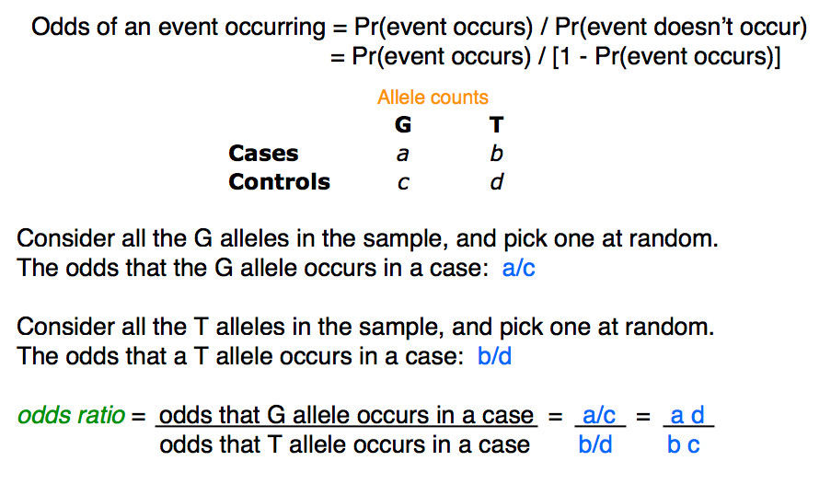
Odds Ratio
Notes:
Instead of significance, we also want to know the odds ratio.

Slide 22
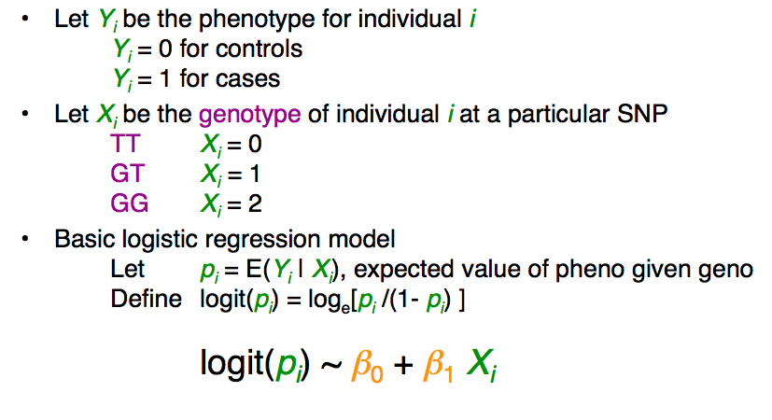
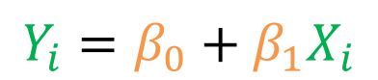
Logistic regression
Analogously, linear regression for continuous phenotype:
$$Y_{i}=β_{0}+β_{1}X_{i}$$
Notes:
Another method to test the significance of SNPs, logistic regression. It’s model based, so it’s more flexible.
Covariates.
Population stratification.
Self reported ethnicity is not accurate

Slide 23
Genotype Imputation
Use genotypes at a few markers to infer genotypes at other unobserved markers
Closely related individuals
Long segments of identify by descent
Distantly related individuals
Shorter segments of identify by descent
Notes:
Genotype imputation. The idea is to use genotypes at a few markers to infer genotypes at other unobserved markers. The reason is that all individuals have some missing SNPs, we can’t exclude the individuals with missing, otherwise we could end up with nothing left.

Slide 24
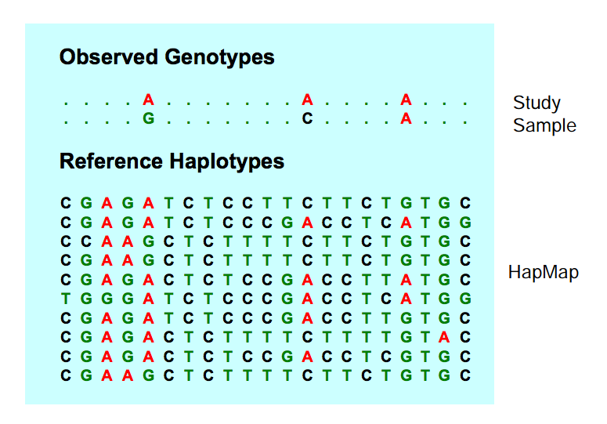
Genotype Imputation for unrelated Individuals
Notes:
The strategy is to match the observed genotypes to the reference genotypes.

Slide 25
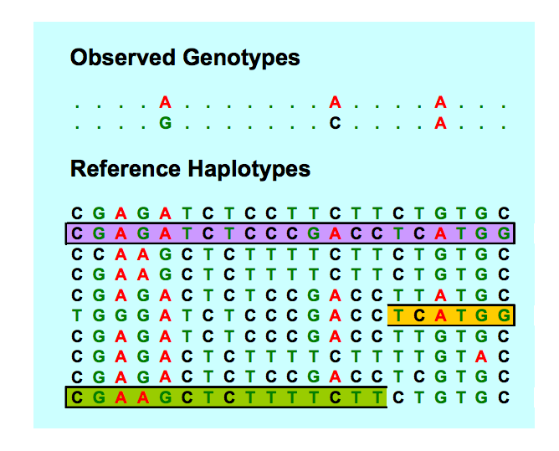
Identify Match Among Reference

Slide 26
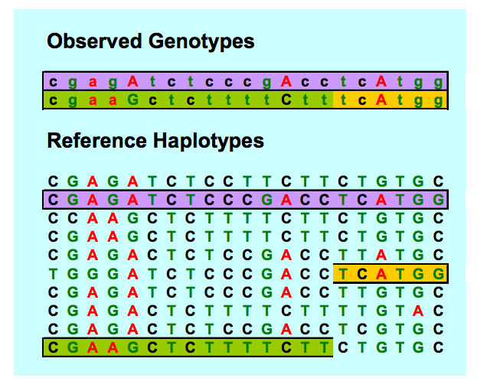
Impute Missing Genotypes and Phase Chromosome

Slide 27
Implementation
Markov model is used to model each haplotype, conditional on all others
At each position, we assume the haplotype being modeled copies as a template haplotype
Each individual has two haplotypes, and therefore copies two template haplotypes
Notes:
… I’m not familiar with this issue.

Slide 28
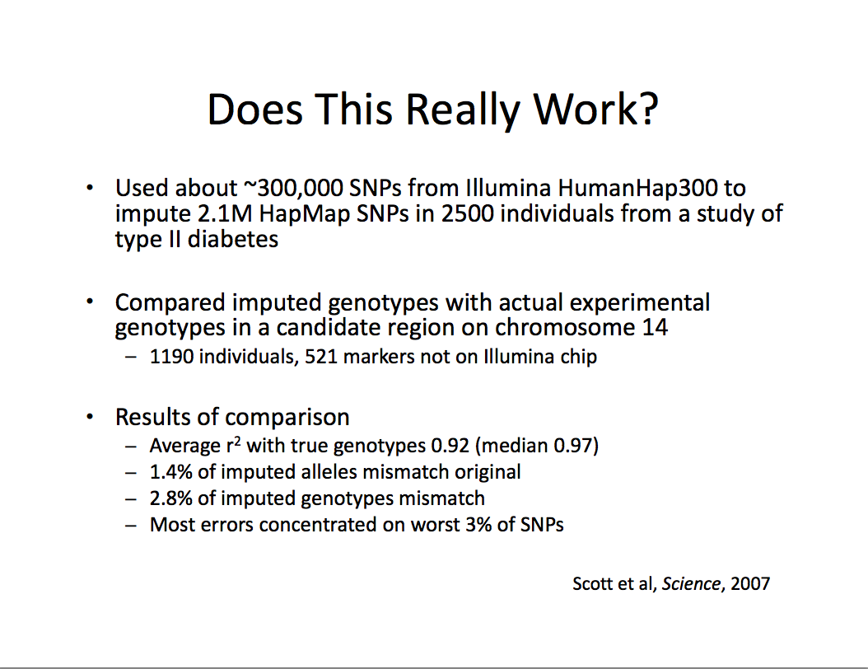
Notes:
Does this really work? It actually works really well, although I’m not familiar with the underling algorithm.

Slide 29
GWAS Workflow
Quality check
Meta analysis
Functional analysis and disease risk prediction
Population stratification
Genotype imputation
Association tests
Notes:
I applied a series of methods to analyze the data.
Use principal components to adjust for population stratification
Use hidden Markov Model to impute genotypes.
Logistic regression and conditional analysis for association tests
Use fisher’s method to combine results from replication studies with original one
Finally, propose a new method to interpret the prediction using GWAS data

Slide 30
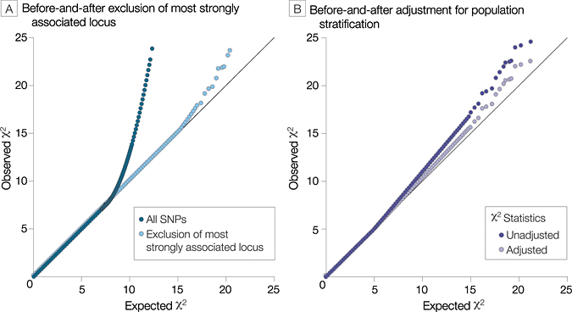
Hypothetical Quantile-Quantile Plots in Genome-wide Association Studies
Pearson, T. A. et al. JAMA 2008;299:1335-1344
Copyright restrictions may apply.
Notes:
These are the Q-Q plots, where each point represents a p-value for the association between the disease and one SNP. If all the SNPs are unrelated with the disease, it would be a straight line on the diagonal. So, this light blue line tells us these SNPs are unrelated with the disease, these a couple of ones are related. This light blue line is kinda the perfect QQ plot.

Slide 31
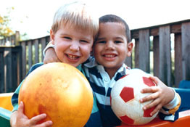

A Successful Example Age Related Macular Degeneration (AMD)
Progressive neurodegenerative disorder which leads to a loss of vision through the death of photoreceptors and/or retinal pigment epithelium (RPE) in the macula
Late stage of the disease is associated with a debilitating loss of central vision and/or blindness
Images from National Eye Institute (http://www.nei.nih.gov)
Normal Vision
Advanced AMD impairment
Notes:
A successful example, age related macular degeneration (AMD). This is people’s normal vision. These are patients with advanced AMD impairment.

Slide 32
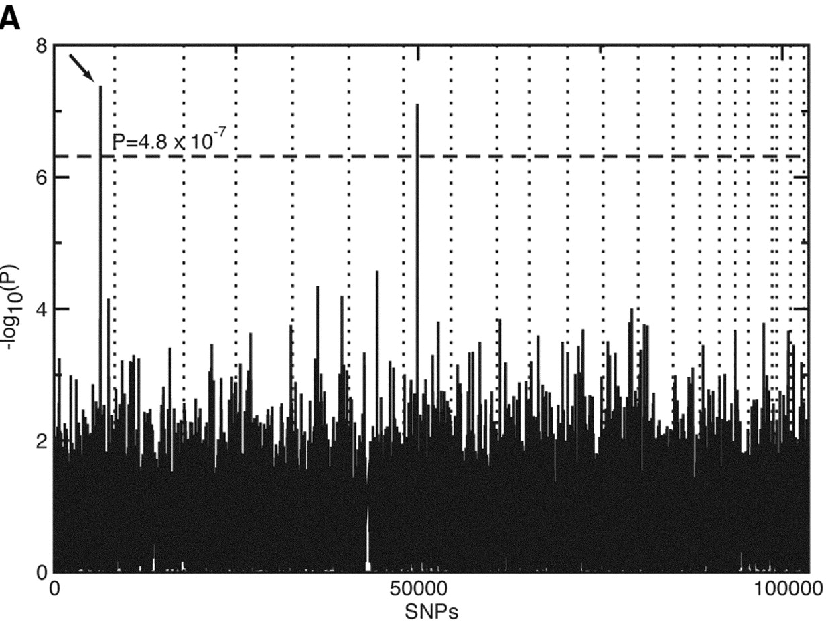
First GWAS of Age-related Macular Degeneration (AMD)
96 cases and 50 controls , 100K SNPs
Klein et al, Science 2005; 308:385-389.
Notes:
This is the first GWAS of AMD. As you can see the sample size is really small, but the finding is obvious. These are the top SNPs.
Multiple testing

Slide 33
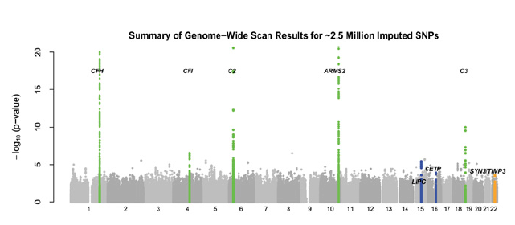
Later GWAS of AMD 2150 cases and 1157controls , 370K SNPs
Chen et al, PNAS 2010
Notes:
This is a later GWAS with larger sample size and more SNPs. We got more signals. Y-axis is …; X-axis is …

Slide 34
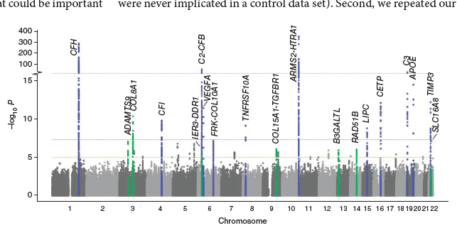
Largest Meta-analysis of AMD > 17,000 cases, > 60,000 controls, 2 M imputed HapMap SNPs
The AMD Gene Consortium, Nat Genet 2013
Notes:
Check out this latest meta-analysis of AMD with a huge sample size and a huge number of SNPs. Even more signals were found.

Slide 35
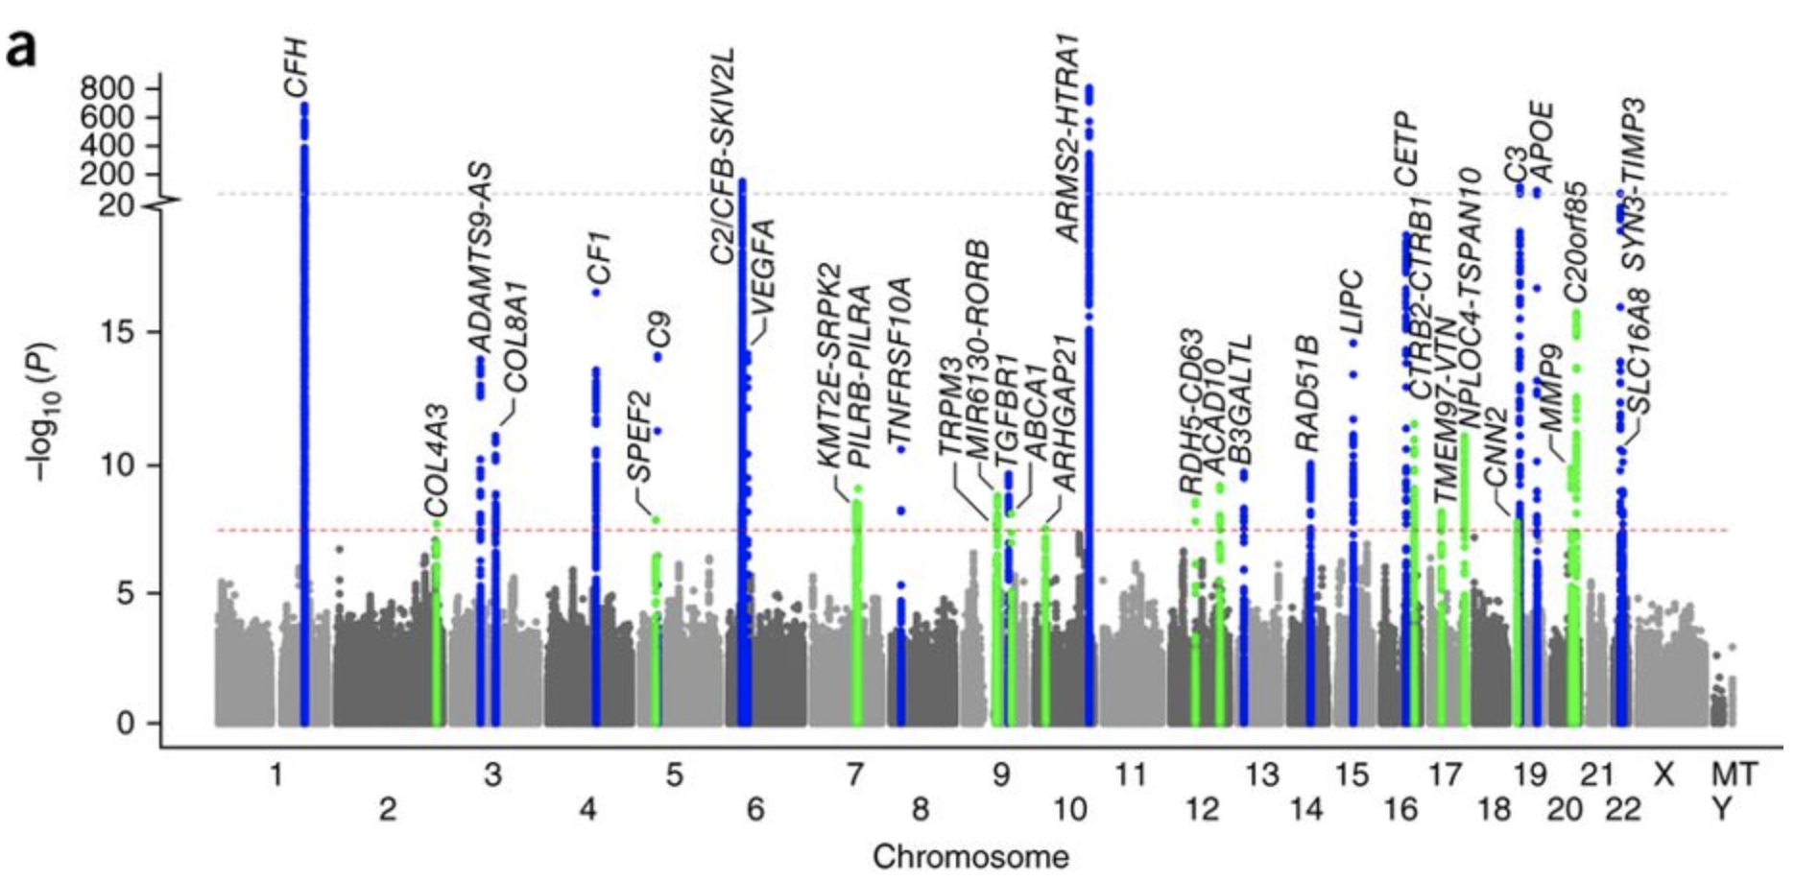
Latest Meta-analysis of AMD 16,144 cases, 17,832 controls, 12 M imputed HapMap SNPs
the International AMD Genomics Consortium (IAMDGC), Nat Genet 2016
Notes:
Check out this latest meta-analysis of AMD with a huge sample size and a huge number of SNPs. Even more signals were found.

Slide 36
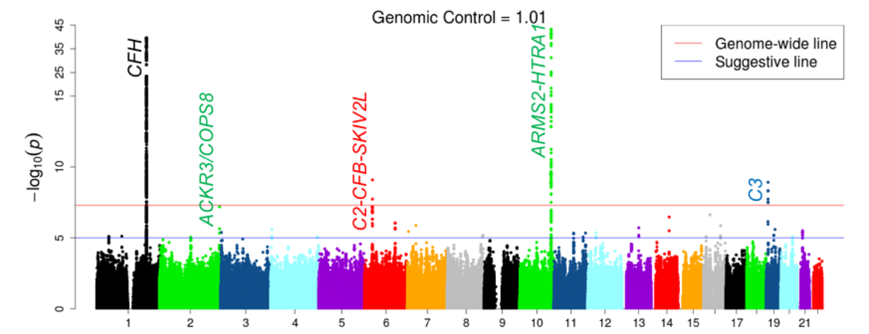

GWAS of AMD Progression 2,721 subjects, 9 M imputed 1000G phase3 SNPs
Yan et al, Human Molecular Genetics 2017

Slide 37
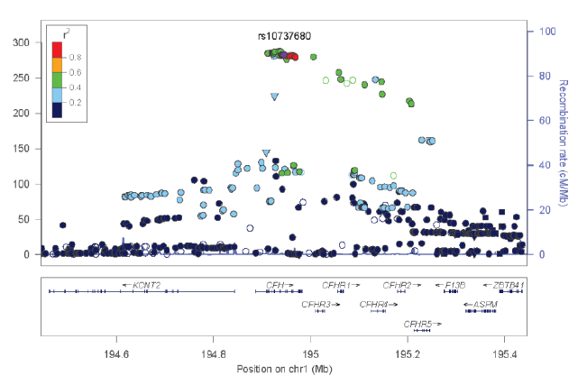
Regional Plots
Notes:
This is the regional plot of the most significant SNP.

Slide 38
GWA Study Design
Genotyping
Imputation
Association
Analysis
Discovery
Meta-analysis
Replication
Meta-analysis
Sample Collection
Genotyping of single nucleotide polymorphisms (SNPs) was performed using a variety of platforms
Array densities ranged from roughly 200k to 1M SNPs/chip
Most samples were population based case-control studies, though some data came from family based (sib-pair) studies
Quality Control (PLINK)
Samples screened unknown for population stratification
Rare SNPs (MAF < 1%-5%) and SNPs with high missing rate were excluded from the analysis
Hardy Weinberg Equilibrium for genotype frequency
Potential familial samples
Nat Genet 2013
Notes:
These are the steps of GWAS design.

Slide 39
GWA Study Design
Genotyping
Imputation
Association
Analysis
Discovery
Meta-analysis
Replication
Meta-analysis
Imputation
Each group participating in the discovery analysis calculated the allelic dosages using IMPUTE2
All imputation was performed using the 1000 Genome Project phase 3 reference panels
Quality Control (PLINK)
SNPs of low imputation quality and/or extreme effect size which tend to indicate spurious associations were removed
After imputation and quality control measures, most data sets contain dosages for over 2 million SNPs per sample
Nat Genet 2013

Slide 40
GWA Study Design
Genotyping
Imputation
Association
Analysis
Discovery
Meta-analysis
Replication
Meta-analysis
Statistical Methods
A logistic regression model, or equivalent analysis, was used to test for association between allelic frequency and AMD risk
Contributing studies adjusted for population substructure as needed
The primary analysis model was unadjusted for age, though subsequent analysis did included age as a covariate
Primary model compared allelic frequencies between all advanced stages of AMD (neovascular AMD and GA) vs controls
PLINK for logistic and linear regression
Nat Genet 2013

Slide 41
GWA Study Design
Genotyping
Imputation
Association
Analysis
Discovery
Meta-analysis
Replication
Meta-analysis
Meta-analysis details
Meta-analysis of all the discovery GWAS was performed via METAL using the inverse fixed affects model
Total number of samples in the discovery analysis was approximately 7,600 cases and 50,000 controls
Discovery Results
From this analysis, 32 loci show promising evidence for association an were further considered for the subsequent stage of replication analysis
Nat Genet 2013

Slide 42
GWA Study Design
Genotyping
Imputation
Association
Analysis
Discovery
Meta-analysis
Replication
Meta-analysis
Follow-up Analysis
32 candidate SNPs from discovery analysis were sent for genotyping in an additional set of non-overlapping case-control samples (N_{case} > 9,500; N_{control} > 8,200)
Replication Results
After meta-analyzing these results with our discovery data,
19 loci attain genome-wide significance (p-values < 5.0 x 10⁻⁸)
Final tally of samples analyzed for SNPs in the replication data set comes to over 17,000 cases and over 60,000 controls
Nat Genet 2013

Slide 43
12 Loci previously observed to have genome-wide association with AMD risk
SNP/ Risk Allele |  |  | Nearby Genes | EAF | Discovery |  | Follow-up |  | Meta
 | Chr Pos(Mb) |  |  |  | P | OR | P | OR | P | OR
rs10490924/T | 10 | 124.2 | ARMS2 | 0.3 | 4×10⁻³⁵³ | 2.7 | 2.8×10⁻¹⁹⁰ | 2.9 | 4×10⁻⁵⁴⁰ | 2.8
rs10737680/A | 1 | 195.0 | CFH | 0.64 | 1×10⁻²⁸³ | 2.4 | 2.7×10⁻¹⁵² | 2.5 | 1×10⁻⁴³⁴ | 2.4
rs429608/G | 6 | 32.0 | C2/CFB | 0.86 | 2×10⁻⁵⁴ | 1.6 | 2.4×10⁻³⁷ | 1.9 | 4×10⁻⁸⁹ | 1.7
rs2230199/C | 19 | 6.7 | C3 | 0.2 | 2×10⁻²⁶ | 1.4 | 3.4×10⁻¹⁷ | 1.4 | 1×10⁻⁴¹ | 1.4
rs5749482/G | 22 | 31.4 | SYN3/TIMP3 | 0.74 | 6×10⁻¹³ | 1.3 | 9.7×10⁻¹⁷ | 1.4 | 2×10⁻²⁶ | 1.3
rs4420638/A | 19 | 50.1 | APOE | 0.83 | 3×10⁻¹⁵ | 1.3 | 4.2×10⁻⁷ | 1.3 | 2×10⁻²⁰ | 1.3
rs1864163/G | 16 | 55.6 | CETP | 0.76 | 8×10⁻¹³ | 1.2 | 8.7×10⁻⁵ | 1.2 | 7×10⁻¹⁶ | 1.2
rs943080/T | 6 | 43.9 | VEGFA | 0.51 | 4×10⁻¹² | 1.2 | 1.6×10⁻⁵ | 1.1 | 9×10⁻¹⁶ | 1.2
rs13278062/T | 8 | 23.1 | TNFRSF10A | 0.48 | 7×10⁻¹⁰ | 1.2 | 6.4×10⁻⁷ | 1.1 | 3×10⁻¹⁵ | 1.2
rs920915/C | 15 | 56.5 | LIPC | 0.48 | 2×10⁻⁹ | 1.1 | 0.004 | 1.1 | 3×10⁻¹¹ | 1.1
rs4698775/G | 4 | 110.8 | CFI | 0.31 | 2×10⁻¹⁰ | 1.2 | 0.025 | 1.1 | 7×10⁻¹¹ | 1.1
rs3812111/T | 6 | 116.6 | FRK/COL10A1 | 0.64 | 7×10⁻⁸ | 1.1 | 0.022 | 1.1 | 2×10⁻⁸ | 1.1
Nat Genet 2013

Slide 44
7 loci showing genome-wide significant association with AMD risk for the first time
SNP/Risk Allele |  |  | Nearby Genes | EAF | Discovery |  | Follow-up |  | Meta
 | Chr Pos |  |  |  | P | OR | P | OR | P | OR
rs13081855/T | 3 | 101.0 Mb | COL8A1 | 0.1 | 4×10⁻¹¹ | 1.3 | 6.0×10⁻⁴ | 1.2 | 4×10⁻¹³ | 1.2
rs3130783/A | 6 | 30.9 Mb | IER3/DDR1 | 0.79 | 1×10⁻⁶ | 1.2 | 3.5×10⁻⁶ | 1.2 | 2×10⁻¹¹ | 1.2
rs8135665/T | 22 | 36.8 Mb | SLC16A8 | 0.21 | 8×10⁻⁸ | 1.2 | 5.6×10⁻⁵ | 1.1 | 2×10⁻¹¹ | 1.2
rs334353/T | 9 | 100.9 Mb | COL15A1/TGFBR1 | 0.73 | 9×10⁻⁷ | 1.1 | 6.7×10⁻⁶ | 1.1 | 3×10⁻¹¹ | 1.1
rs8017304/A | 14 | 67.9 Mb | RAD51B | 0.61 | 9×10⁻⁷ | 1.1 | 2.1×10⁻⁵ | 1.1 | 9×10⁻¹¹ | 1.1
rs6795735/T | 3 | 64.7 Mb | ADAMTS9 | 0.46 | 9×10⁻⁸ | 1.1 | 0.0066 | 1.1 | 5×10⁻⁹ | 1.1
rs9542236/C | 13 | 30.7 Mb | B3GALTL | 0.44 | 2×10⁻⁶ | 1.1 | 0.0018 | 1.1 | 2×10⁻⁸ | 1.1
Nat Genet 2013

Slide 45
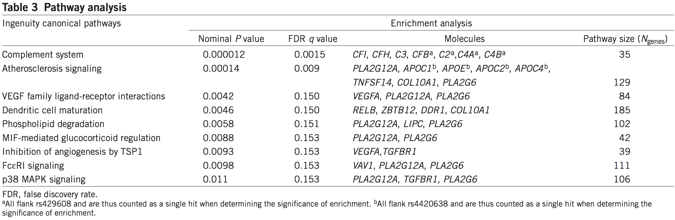
Functional Analysis
Gene set enrichment of all implicated results was run using Ingenuity Pathway Analysis (IPA) software.
Nat Genet 2013

Slide 46
Summary
GWAS have been successful in identifying genetic variants associated with common diseases and traits.
A large proportion of heritability remains unexplained by GWAS and very limited functional knowledge is known at most identified loci.
Next generation sequencing will be the next step to dissect the genetic basis beyond GWAS.

Slide 47
References
http://www.genome.gov/gwastudies/
http://pngu.mgh.harvard.edu/~purcell/plink/
Mark I. McCarthy et al. Genome-wide association studies for complex traits: consensus, uncertainty and challenges. Nature Review Genetics. 2008
The AMD Gene Consortium. Seven New Loci Associated with Age-Related Macular Degeneration. Nature Genetics. 2013
The International AMD Genomics Consortium (IAMDGC). A large genome-wide association study of age-related macular degeneration highlights contributions of rare and common variants. Nature Genetics. 2016

